Slide 1
Digital Signature Approach
1
1

Slide 2
X.509 Authentication Service
More broadly X.509 defines a framework to provide a secure directory services.
Distributed set of servers that maintains a database about users.
Each certificate contains the public key of a user and is signed with the private key of a CA.
Is used in S/MIME, IP Security, SSL/TLS and SET.
RSA is recommended to use
2
2

Slide 3
X.509 Formats
Henric Johnson
3
3

Slide 4
Obtaining a User’s Certificate
Characteristics of certificates generated by CA:
Any user with access to the public key of the CA can verify the user public key that was certified.
No party other than the CA can modify the certificate without this being detected.
4
4

Slide 5
X.509 CA Hierarchy
User A acquires following certificates from the directory to establish certification path to user B:
X<<W>>W<<V>>V<<Y>>Y<<Z>>Z<<B>>
5
5

Slide 6
Description of X.509 Version 3
The following requirements not satisfied by version 2:-
Subject field is inadequate to convey the identity of a key owner.
The subject field is also inadequate for many applications
There is need to indicate security policy information
There is a need to specify particular public key among several public keys of same CA or user
Need to specify constraints on the applicability of a particular certificate

Slide 7
Version 3 includes “extension” field, which is optional. The certificate extensions fall into three main categories.
(1) Key and policy information
(2) Subject and issuer attributes
(3) Certification path constraints
(1) Key and policy information:
i) Authority key identifier
ii)Subject key identifier
iii)key usage
iv) private key usage period
v) certificate policies
vi) policy mappings

Slide 8
(2) Subject and Issuer attributes:
(I) Subject alternative name
(ii) Issuer alternative name
(iii) Subject directory attribute
(3) Certification path constraints:
(I) Basic constraints: If subject is CA, then certification path length constraint may be specified.
(ii) Name constraints
(iii) Policy constraints: Inhibit policy mapping for the remainder of the certification path

Slide 9
Revocation of Certificates
Reasons for revocation:
The users secret key is assumed to be compromised.
The user is no longer certified by this CA.
The CA’s certificate is assumed to be compromised.
9
9

Slide 10
Key Management
public-key encryption helps address key distribution problems
have two aspects of this:
distribution of public keys
use of public-key encryption to distribute secret keys
Notes:
One of the major roles of public-key encryption has been to address the problem of key distribution, with two distinct aspects: the distribution of public keys, and the use of public-key encryption to distribute secret keys.

Slide 11
Distribution of Public Keys
can be considered as using one of:
public announcement
publicly available directory
public-key authority
public-key certificates
Notes:
Several techniques have been proposed for the distribution of public keys, which can mostly be grouped into the categories shown.

Slide 12
Key Management Public-Key Certificate Use
Henric Johnson
12

Slide 13
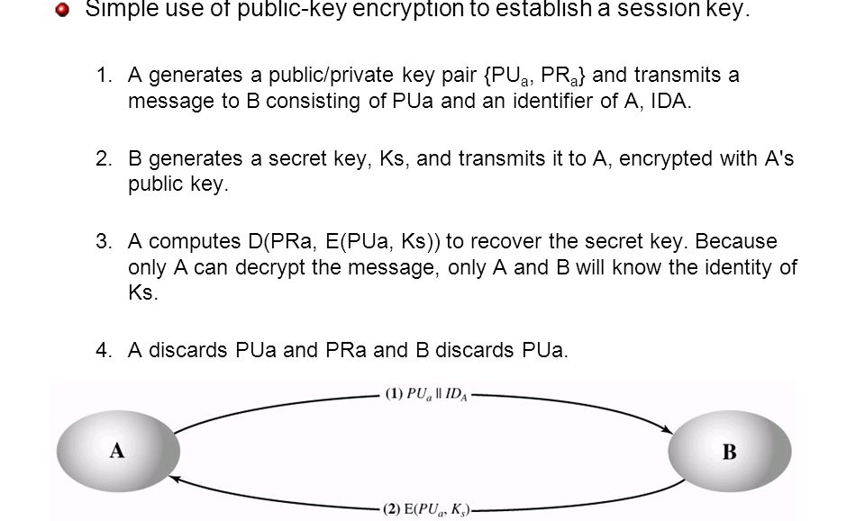
Public-Key Distribution of Secret Keys Digital Envelope
use previous methods to obtain public-key
can use for secrecy or authentication
but public-key algorithms are slow
so usually want to use private-key encryption to protect message contents
hence need a session key
have several alternatives for negotiating a suitable session
Notes:
Once public keys have been distributed or have become accessible, secure communication that thwarts eavesdropping, tampering, or both, is possible. However, few users will wish to make exclusive use of public-key encryption for communication because of the relatively slow data rates that can be achieved. Accordingly, public-key encryption provides for the distribution of secret keys to be used for conventional encryption.

Slide 14
Authentication
Requirements - must be able to verify that:
1. Message came from apparent source or author,
2. Contents have not been altered,
3. Sometimes, it was sent at a certain time or sequence.
Protection against active attack (falsification of data and transactions)

Slide 15
Approaches to Message Authentication
Authentication Using Conventional Encryption
Only the sender and receiver should share a key.
Message with an error-detection code and a sequence no, timestamp.
Message Authentication without Message Encryption
-Message Authentication Code
-One-Way hash function
15

Slide 16
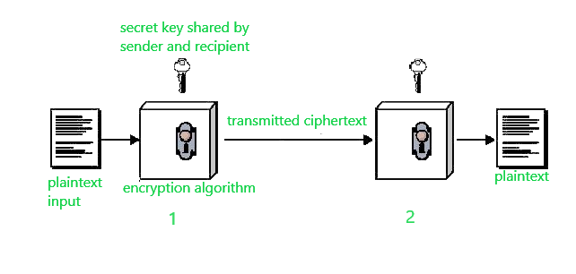
1. Message Authentication Using Conventional Encryption
Message authentication using conventional (symmetric) encryption ensures that a message
comes from the right sender and has not been changed. It relies on a shared secret key,
error-detection codes, and sequence numbers.
The sender prepares a message (M), adds timestamp, sequence and error-detection code
(like a checksum or FCS), and encrypts the entire block using the secret key
The receiver decrypts the ciphertext using the same secret key. If the decrypted message has a
valid error-detection code, the receiver accepts it as authentic and unchanged. The sequence number and time stamp is verified to check the message is duplicate or original

Slide 17
2. Message Authentication without Message Encryption -Message Authentication Code
_{MACM=F(KAB,M)}

Slide 18
If received code matches the calculated code, then:
The receiver is assured that the message has not altered.
The receiver is assured that the message is from the alleged sender.
If the message includes a sequence number, then the receiver can be assured of the proper sequence, because an attacker cannot successfully alter the sequence number.

Slide 19
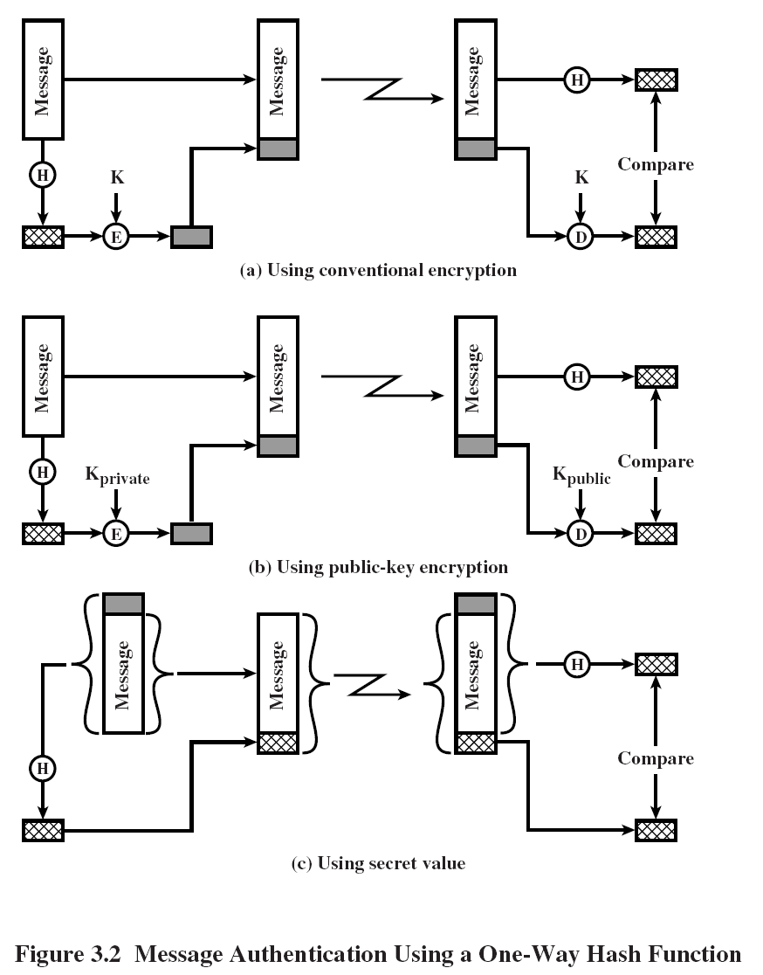
2. Message Authentication without Message Encryption
-One-Way hash function

Slide 20
Secure HASH Functions
Purpose of the HASH function is to produce a ”fingerprint.
Properties of a HASH function H :
H can be applied to a block of data of any size
H produces a fixed length output
H(x) is easy to compute for any given x.
For any given code h, it is computationally infeasible to find x such that H(x) = h. One way hash function
For any given block x, it is computationally infeasible to find with H(y) = H(x). This is strong collision resistance
It is computationally infeasible to find any pair (x, y) such that H(x) = H(y). This is weak collision resistance
20

Slide 21
Simple Hash Function
b₁₁ xor b₁₂ xor …..xor b_{1m}

Slide 22
SHA-1
The algorithm takes as input a message with a maximum length of less than 2^64 bits and produces as output a 160-bit message digest.
The input is processed in 512-bit blocks.
^{Steps}
pad message so its length is 448 mod 512
append a 64-bit length value to message
initialise 5-word (160-bit) buffer (A,B,C,D,E) to
(67452301,efcdab89,98badcfe,10325476,c3d2e1f0)
process message in 16-word (512-bit) blocks:
expand 16 words into 80 words by mixing & shifting
use 4 rounds of 20 bit operations on message block & buffer
add output to input to form new buffer value
output hash value is the final buffer value
22

Slide 23
Message Digest Generation Using
Secure Hash Algorithm – 1 (SHA-1)
23

Slide 24
SHA-1 Processing of single 512-Bit Block

Slide 25
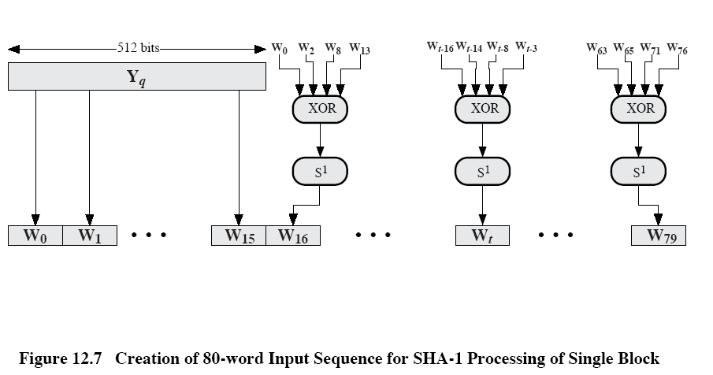

Slide 26
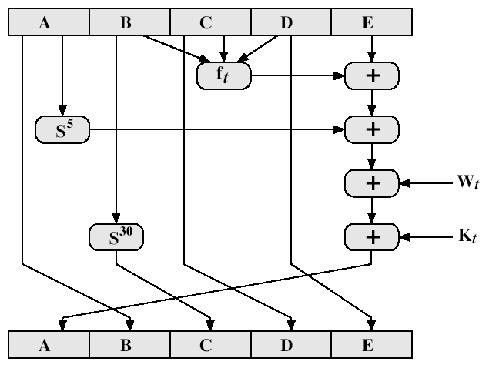
^{SHA-1 Compression Function}
26

Slide 27
^{SHA-1 Compression Function}
each round has 20 steps which replaces the 5 buffer words thus:
(A,B,C,D,E) <-(E+f(t,B,C,D)+S5(A)+W_{t}^{+K}_{t}^{),A,S30(B),C,D}
a,b,c,d refer to the 4 words of the buffer
^{t is the step number}
f(t,B,C,D) is nonlinear function for round
^{W}_{t} is derived from the message block
^{Kt is an additive constant}
^{+ addition modulo 232}
27

Slide 28
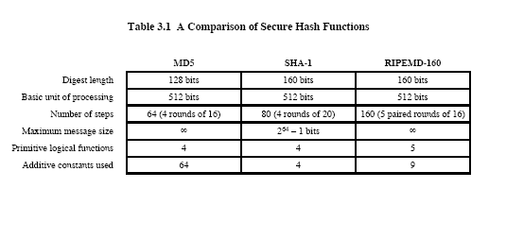
Other Secure HASH functions

Slide 29
HMAC
Use a MAC derived from a cryptographic hash code, such as SHA-1.
Motivations:
Cryptographic hash functions executes faster in software than encryptoin algorithms such as DES
Library code for cryptographic hash functions is widely available
No export restrictions from the US
A cryptographic hash function: hash function which takes an input (or 'message') and returns a fixed-size alphanumeric string, which is called the hash value (sometimes called a message digest, a digital fingerprint, a digest or a checksum).
29

Slide 30
HMAC Design Objectives
To use without modifications, available hash functions-in particular, hash functions that perform well in software, and for which code is freely and widely available.
To allow for easy replaceability of the embedded hash functions in case faster or more secure hash functions are found or required.
To preserve the original performance of the hash functions without incurring a significant degradation.
To use and handle keys in a simple way.
To have a well understood cryptographic analysis of the strength of the authentication mechanism based on reasonable assumptions about embedded hash function.

Slide 31
HMAC Structure

Slide 32
H = embedded hash function (e.g., SHA-1)
IV= initial value input to hash function
M = message input to HMAC (including the padding specified in the embedded hash function)
Y_{i} = i th block of M, 0 ≤ i ≤ (L-1)
L = number of blocks in M
b = number of bits in a block
n = length of hash code produced by embedded hash function
K = secret key; if key>b;the key is input to hash fun to produce an n-bit key:recommended length is >=n.
K+ = K padded with zeros on the left so that the result is b bits in length
ipad = 00110110 (36 in hexadecimal) repeated b/8 times
opad = 01011100 (5C in hexadecimal) repeated b/8 times
Then HMAC can be expressed as follows:
HMAC_{k} = H[(K+ opad) || H[(K+ ipad) || M]]

Slide 33
HMAC Algorithm
1.Append zeros to the left end of K to create a b-bit string K⁺ (e.g., if K is of length 160 bits and b=512, then K will be appended with 44 zero bytes 0x00).
2.XOR K⁺ with ipad to produce the b-bit block s_{i}
3.Append M to s_{i}
4.Apply H to the stream generated in step3
5.XOR K⁺ with opad to produce the b-bit block s₀
6.Append the hash result from step4 to s₀
7.Apply H to the stream generated in step6 and output the result.

Slide 34
KERBEROS
What?
Computer network authentication protocol
How?
Works on the basis of 'tickets'
Why?
Allow nodes communicating over a non-secure network to prove their identity to one another in a secure manner.
Users wish to access services on servers.
Three threats exist:
User pretend to be another user.
User alter the network address of a workstation.
User eavesdrop on exchanges and use a replay attack.
34
34

Slide 35
KERBEROS
Provides a centralized authentication server to authenticate users to servers and servers to users.
Relies on conventional encryption, making no use of public-key encryption
Two versions: version 4 and 5
Version 4 makes use of DES
35
35

Slide 36
Kerberos Requirements
its first report identified requirements as:
secure
reliable
transparent
scalable
implemented using an authentication protocol based on Needham-Schroeder
Notes:
In a more open environment, in which network connections to other machines are supported, an approach that requires the user to prove his or her identity for each service invoked, and also require that servers prove their identity to clients, is needed to protect user information and resources housed at the server. Kerberos supports this approach, and assumes a distributed client/server architecture that employs one or more Kerberos servers to provide an authentication service. The first published report on Kerberos [STEI88] listed the following requirements:
• Secure: A network eavesdropper should not be able to obtain the necessary information to impersonate a user. More generally, Kerberos should be strong enough that a potential opponent does not find it to be the weak link.
• Reliable: For all services that rely on Kerberos for access control, lack of availability of the Kerberos service means lack of availability of the supported services. Hence, Kerberos should be highly reliable and should employ a distributed server architecture, with one system able to back up another.
• Transparent: Ideally, the user should not be aware that authentication is taking place, beyond the requirement to enter a password.
• Scalable: The system should be capable of supporting large numbers of clients and servers. This suggests a modular, distributed architecture.
To support these requirements, Kerberos is a trusted third-party authentication service that uses a protocol based on that proposed by Needham and Schroeder which was discussed earlier in this chapter.

Slide 37
Kerberos Version 4
Terms:
C = Client
AS = authentication server
V = server
IDc = identifier of user on C
IDv = identifier of V
P_{c} = password of user on C
ADc = network address of C
Kv = secret encryption key shared by AS and V
TS = timestamp
|| = concatenation
Henric Johnson
37
37

Slide 38

A Simple Authentication Dialogue
C  AS: IDc || P_{c} || IDv
AS  C: Ticket
C  V: IDc || Ticket
Ticket = E_{Kv}[IDc || AD_{c} || IDv]
AS
C: Client
CW: Client Workstation
AS: Authentication Server
AS_{DB}: AS database
V: File Server
F: File
_{Kv: Key known only to AS and V}
IDc || P_{c} || IDv
AS_{DB}
Ticket
C
_{Kv}
CW
IDc || Ticket
V
F
Requested file
_{Kv}
38
38

Slide 39
Disadvantagesin the Authentication Dialogue
AS
IDc || P_{c} || IDv1
AS_{DB}
C
Ticket1
_{Kv1}
CW
IDc || Ticket1
V1
F
Requested file
_{Kv1}
Requested mail
V2
IDc || Ticket2
Mail Server
_{Kv2}
Problems:
As password is sent as plaintext, hackers may get hold of it and use illegally.
2. For different server, different ticket is to be obtained by the client.
39
39

Slide 40
Overcoming Problems in Kerberos v4:
Password not to be sent to AS
Introduce new sever: Ticket Granting server (TGS)
Overview
a basic third-party authentication scheme
have an Authentication Server (AS)
users initially negotiate with AS to identify self
AS provides a non-corruptible authentication credential (ticket granting ticket TGT)
have a Ticket Granting server (TGS)
users subsequently request access to other services from TGS on basis of users TGT
using a complex protocol using DES
Notes:
The core of Kerberos is the Authentication and Ticket Granting Servers – these are trusted by all users and servers and must be securely administered. The protocol includes a sequence of interactions between the client, AS, TGT and desired server. Version 4 of Kerberos makes use of DES, in a rather elaborate protocol, to provide the authentication service. Viewing the protocol as a whole, it can be difficult to see the need for the many elements contained therein. The text contains more detailed discussion about the development of and need for the components of the final v4 protocol.

Slide 41
A more secure Authentication Dialogue
User C wants Server V access
AS
AS_{DB}
C
K_{tgs}
E(K_{c}, Ticket_{tgs})
CW
*
IDc || ID_{v}||Ticket_{tgs}
TGS
*
K_{tgs}
Ticket_{v}
_{Kv}
Requested file
V
F
IDc || Ticket_{v}
_{Kv}
K_{c}=f(P_{c})
Ticket_{tgs}= E(K_{tgs,}[IDc || AD_{c}||ID_{tgs}||TS₁||Lifetime₁])
Ticket_{v}= E(K_{v,}[IDc || AD_{c}||ID_{v}||TS₂||Lifetime₂])

Slide 42
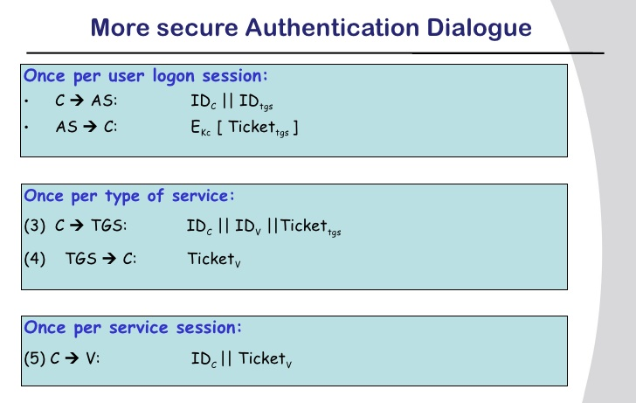
Ticket_{tgs}= E(K_{tgs,}[IDc || AD_{c}||ID_{tgs}||TS₁||Lifetime₁])
Ticket_{v}= E(K_{v,}[IDc || AD_{c}||ID_{v}||TS₂||Lifetime₂])

Slide 43
Problems with Version 4 Authentication Dialogue
Problems:
Lifetime associated with the ticket-granting ticket
If too short  repeatedly asked for password
As password is sent as plaintext, hackers may get hold of it and use illegally.
If too long  greater opportunity to replay
The threat is that an opponent will steal the ticket and use it before it expires
2. If opponent captures Ticket_{tgs} and uses it before it expires, the opponent has access to the corresponding service.
Solution to this: So TGS must authenticate itself to the client so that client passes the request to the right TGS and not to false server.
A session key K_{c,tgs} is passed secretly to Client and TGS by AS.
43
43

Slide 44
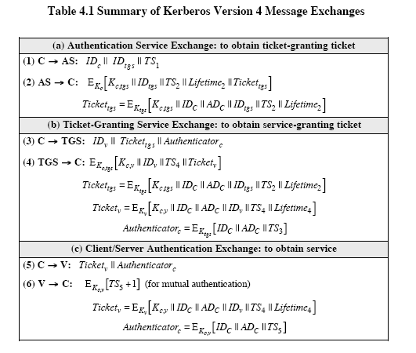
Version 4 Authentication Dialogue

Slide 45
Overview of Kerberos
Henric Johnson
45
45

Slide 46
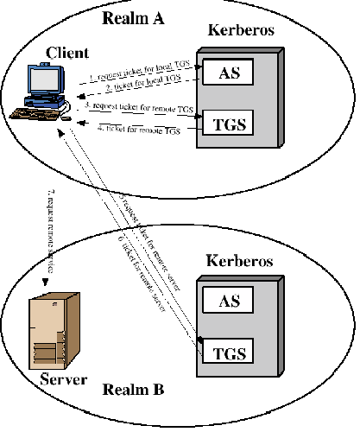
Request for Service in Another Realm
Henric Johnson
46
46

Slide 47
Difference Between Version 4 and 5
A. Environmental Shortcomings
Encryption system dependence (V.4 DES)
Internet protocol dependence
Message byte ordering
Ticket lifetime
Authentication forwarding
Interrealm authentication
47
47

Slide 48
Differences Between V4 and V5 …
B. Technical deficiencies
Double encryption:
PCBC encryption: Propagating CBC is used in V4 and this is non-standard. In V5 CBC is used.
Session key: Each ticket includes a session key that can be used to encrypt the authenticator. Since the same key is used repeatedly to gain a service from particular server, there is a risk that an opponent can replay messages from an old session to the client or server. In V5 this is avoided by requiring a sub session key which is used only for one connection.

Slide 49
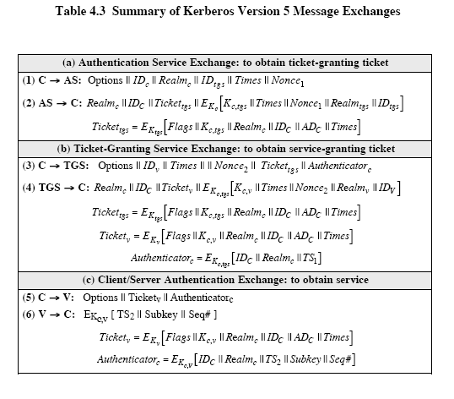
Version 5 Authentication Dialogue
49

Slide 50
Pretty Good Privacy
Philip R. Zimmerman is the creator of PGP.
PGP provides a confidentiality and authentication service that can be used for electronic mail and file storage applications.

Slide 51
Why Is PGP Popular?
It is availiable free on a variety of platforms.
Based on well known algorithms.
Wide range of applicability
Not developed or controlled by governmental or standards organizations

Slide 52
Operational Description
Consist of five services:
Authentication (Provided through DSS)
Confidentiality (Done thru Symmetric Key Encryption algorithms)
Compression (ZIP algorithm)
E-mail compatibility (Using Radix 64 Conversion)
Segmentation (as used in the OS)

Slide 53
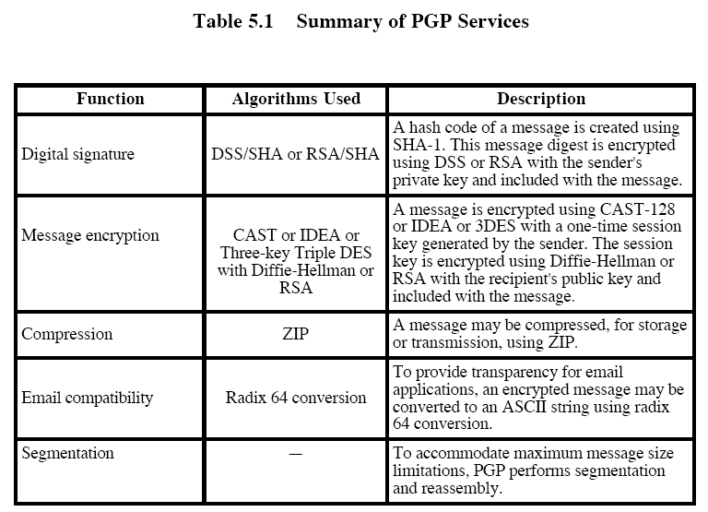

Slide 54
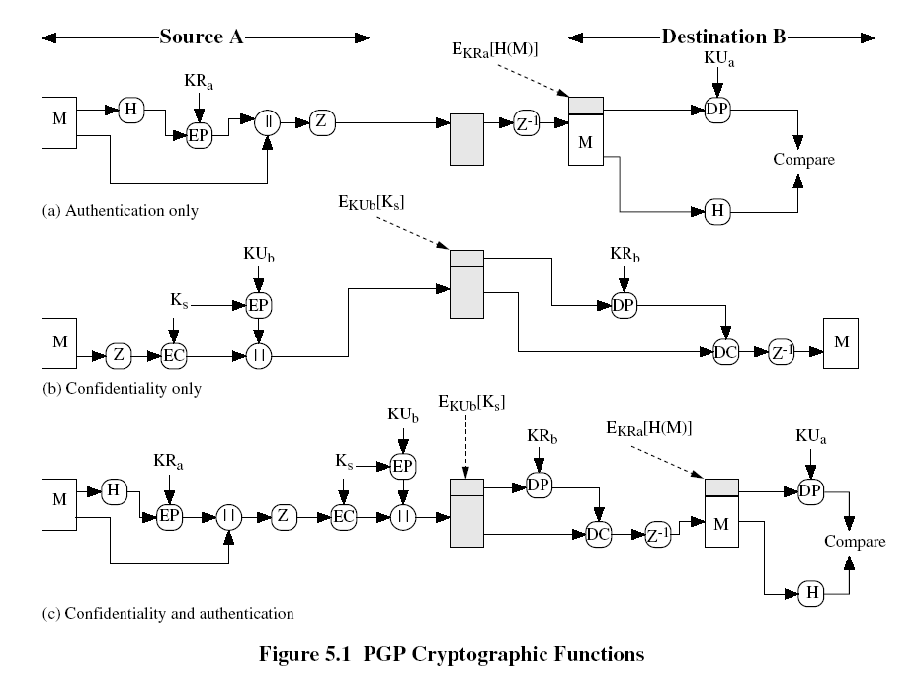

Slide 55
Compression
PGP compresses the message after applying the signature but before encryption
Z in the earlier diagrams represent the compression function.
The placement of the compression algorithm is critical.
The compression algorithm used is ZIP

Slide 56
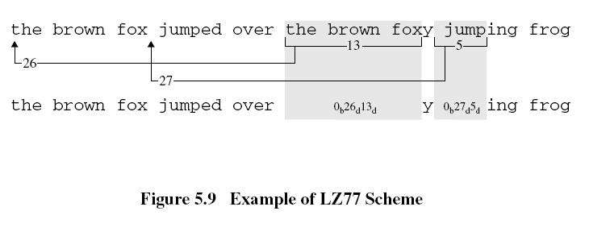
Octets: 53 (characters including spaces)
Binary form= 424 bits
Repeated Sequencs: 2
Seq1: the brown fox : 13 chars
Offset1: 26 characters
Seq2: jump : 5 chars
Offset2: 27 characters
Seq1 code: 0 26 13
Seq1 code: 0 27 5
Encoding format: offset: 8 and length: 4 → 00
offset: 12 and length: 6 →01
Compressed message: 35 9-bit chars and 2 codes
So 35*9+2*14= 343 bits
Compression ratio: 1.24

Slide 57
LZ77- Ziv and Lempel in 1977
This algorithm is based on a portion of the previous encoded sequence
The encoder examines the input sequence through a sliding window
The sliding window consists of two parts
Search Buffer
Look-ahead Buffer

Slide 58
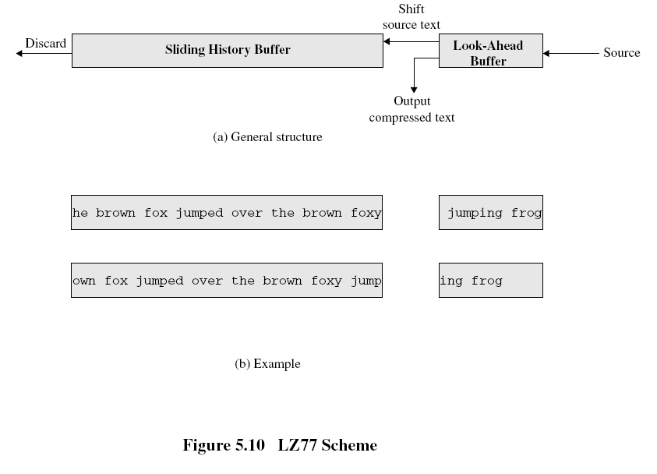

Slide 59
E-mail Compatibility
The scheme used is radix-64 conversion.
Base64 (Radix-64) encoding schemes – used to encode binary data that need to be stored and transferred over media that are designed to deal with textual data.
This is to ensure that the data remain intact without modification during transport.
The use of radix-64 expands the message by 33%.

Slide 60
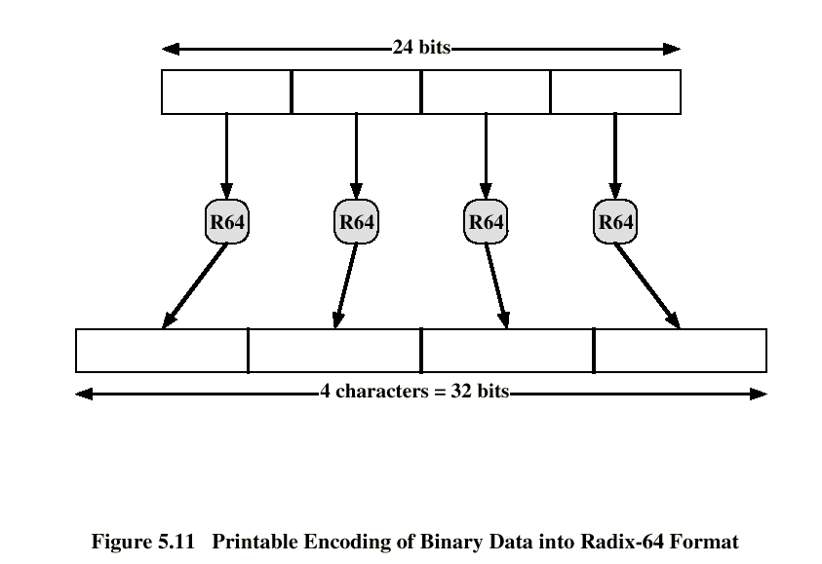

Slide 61
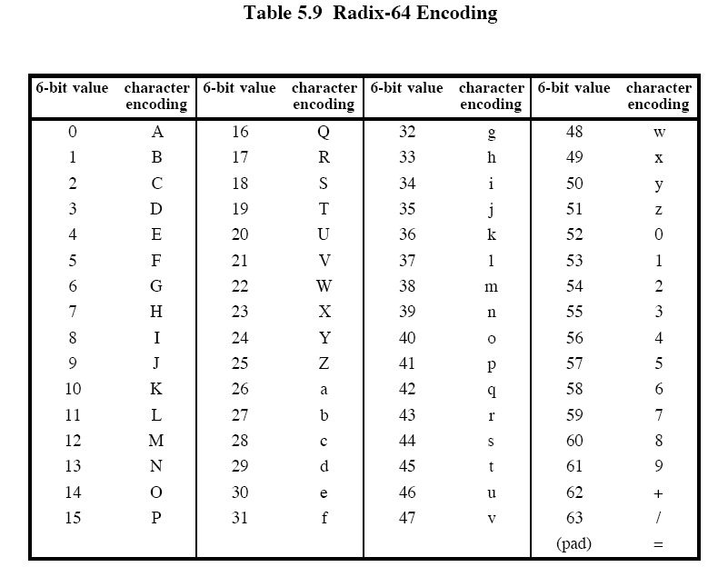

Slide 62
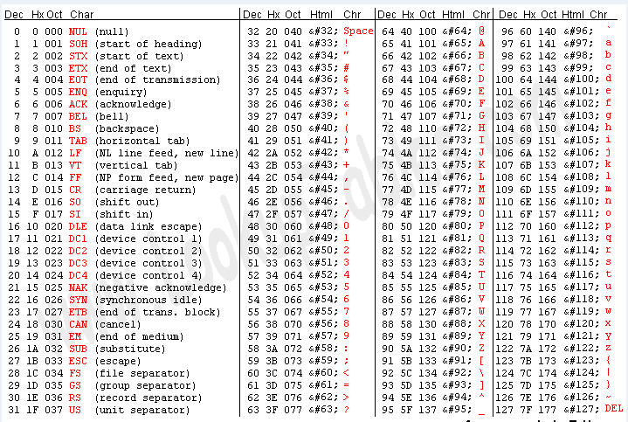

Slide 63
i/p : 00100011 01011100 10010001
2 3 5 C 9 1 (in hexadecimal)
arrange this input in blocks of 6 bits:
001000 110101 110010 010001
I 1 y R (in radix-64)
If these characters are stored in 8-bit ASCII format with parity bit set to zero , we have
01001001 00110001 01111001 01010010
o/p : 4 9 3 1 7 9 5 2
Character | ASCII Value | Binary form
I | 73 | 1001001
1 | 49 | 0110001
Y | 121 | 1111001
R | 82 | 1010010

Slide 64
Segmentation and Reassembly
Often restricted to a maximum message length of 50,000 octets.
Longer messages must be broken up into segments.
PGP automatically subdivides a message that is too large.
The receiver strip of all e-mail headers and reassemble the block.

Slide 65
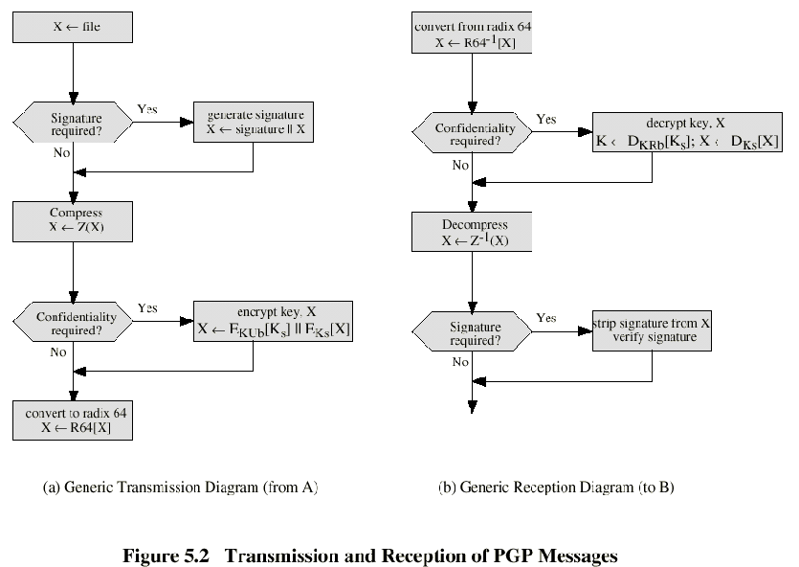

Slide 66
S/MIME
S/MIME: Secure/Multipurpose Internet Mail Extension
S/MIME will probably emerge as the industry standard.
PGP for personal e-mail security

Slide 67
Simple Mail Transfer Protocol (SMTP, RFC 822)
SMTP Limitations - Can not transmit, or has a problem with:
executable files, or other binary files (jpeg image)
“national language” characters (non-ASCII)
messages over a certain size
ASCII to EBCDIC translation problems
lines longer than a certain length (72 to 254 characters)

Slide 68
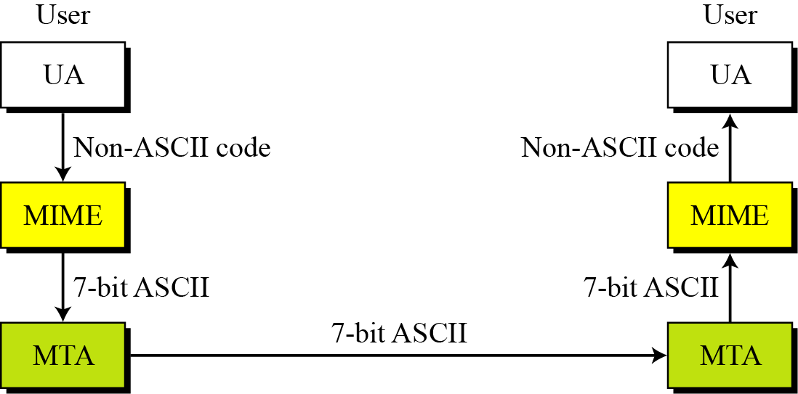
Figure MIME

Slide 69
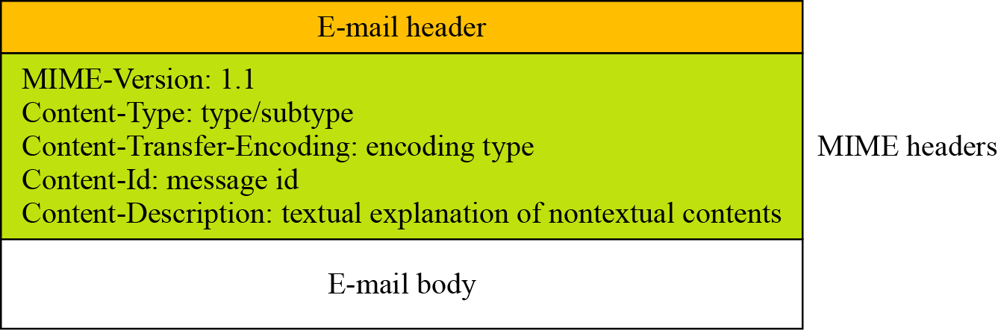
Figure MIME header

Slide 70
Text

Slide 71
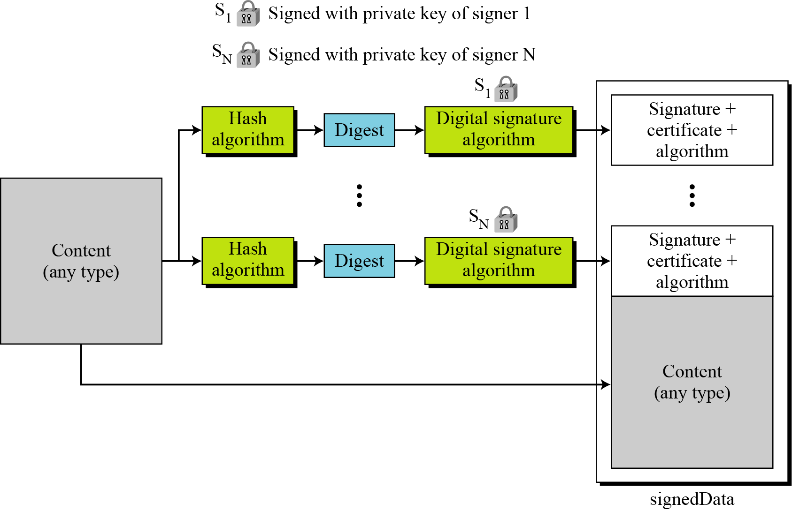
S/MIME
Figure Signed-data content type

Slide 72
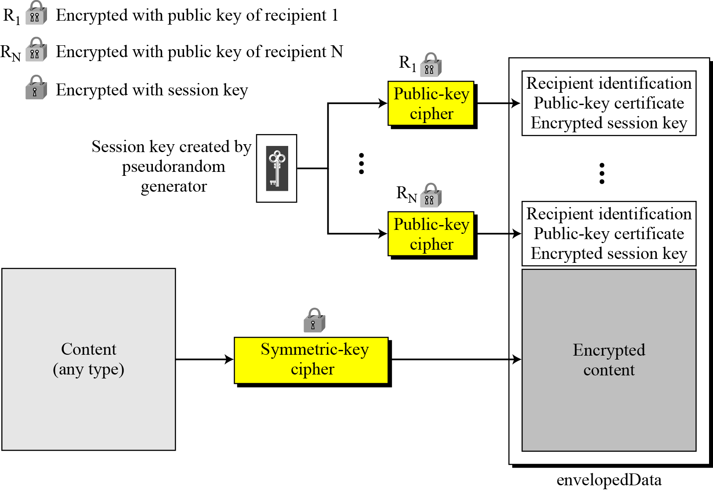
Enveloped-data content type

Slide 73
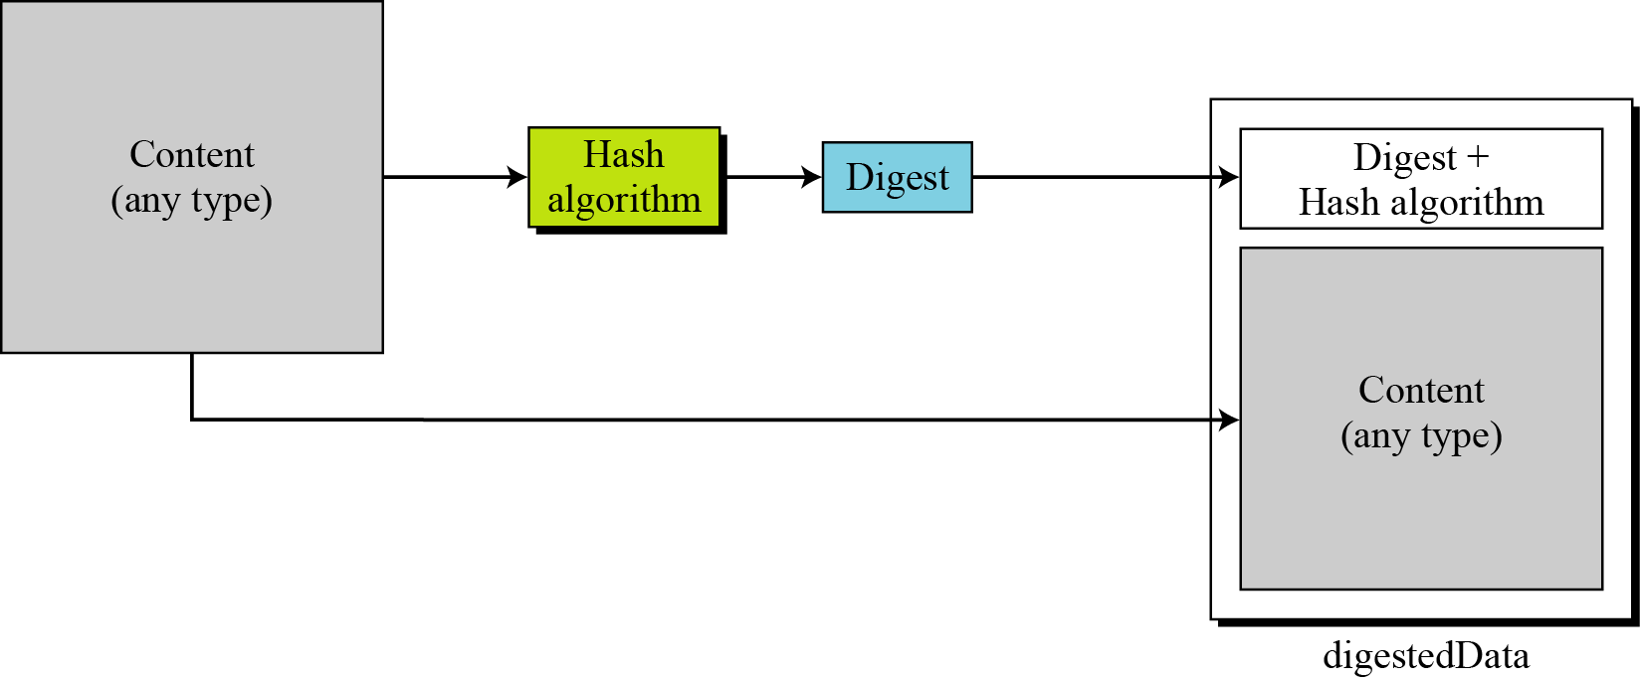
Figure Digest-data content type

Slide 74
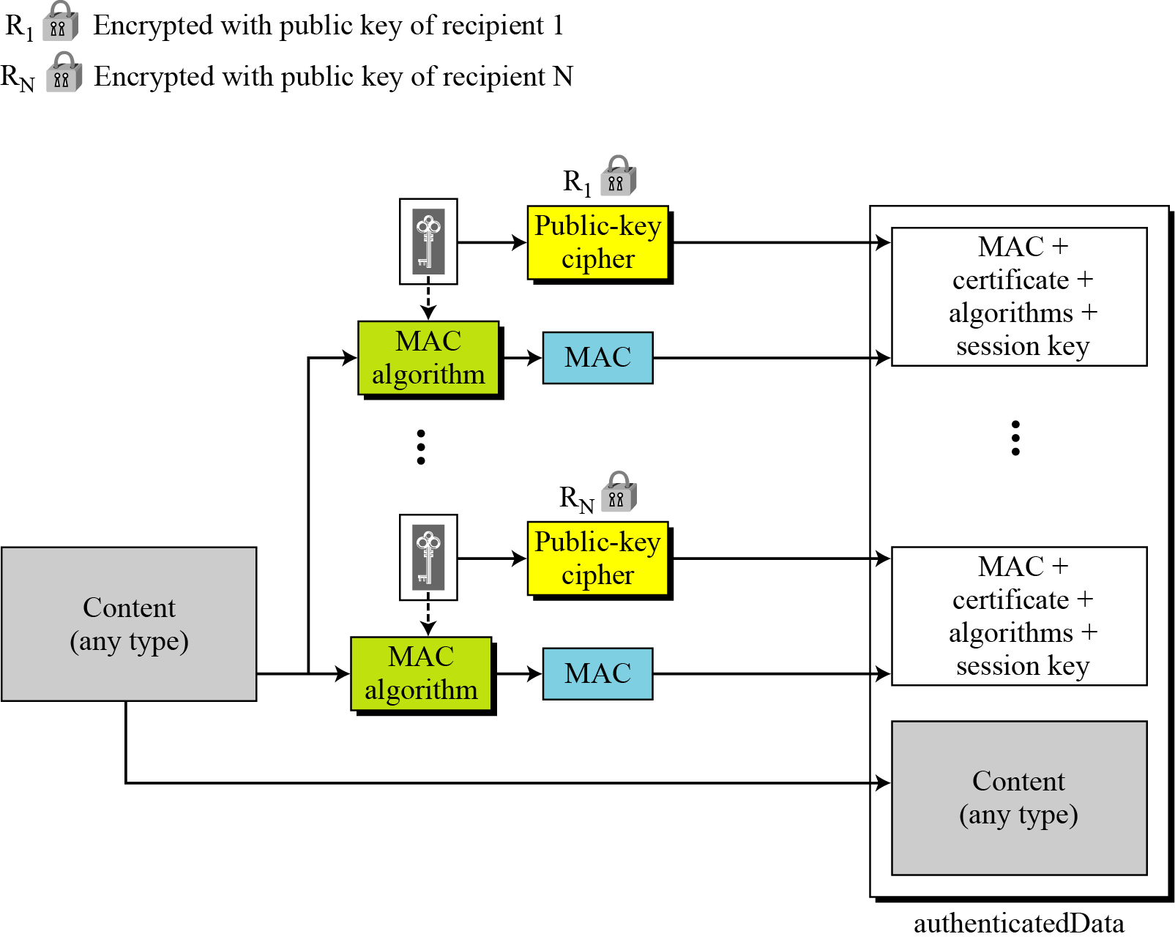
Figure Authenticated-data content type

Slide 76
S/MIME Functions
Enveloped Data: Encrypted content and encrypted session keys for recipients.
Signed Data: Message Digest encrypted with private key of “signer.”
Clear-Signed Data: Signed but not encrypted.
Signed and Enveloped Data: Various orderings for encrypting and signing.

Slide 77
User Agent Role
S/MIME uses Public-Key Certificates - X.509 version 3 signed by Certification Authority
Functions:
Key Generation - Diffie-Hellman, DSS, and RSA key-pairs.
Registration - Public keys must be registered with X.509 CA.
Certificate Storage - Local (as in browser application) for different services.

